Slide 1

An Introduction to Support Vector Machine Classification for BCI
By
Huafu Chen

Slide 2
Outline
What do we mean with classification, why is it useful
Machine learning- basic concept
Support Vector Machines (SVM)
  Linear SVM – basic principle
  Non-linear SVM – the Kernel trick
An example:EEG of motor imaginary classifing with SVM

Slide 3
Classification tasks in BCI
Learning Task
  Given: feature vectors of the labeled trials.
  Compute: A model (SVM parameters) distinguishing the mental states of the particular user.
Classification Task
  Given: feature vectors of the unlabeled trials+ a learned model
  Determine: the specific brain states.

Slide 4
Problems in classifying EEG data
Often high dimension of data (multi-channels).
Amount of data.
Need automated ways to deal with the data.
data processing, statistical analysis, try to learn patterns from the data on-line

Slide 5
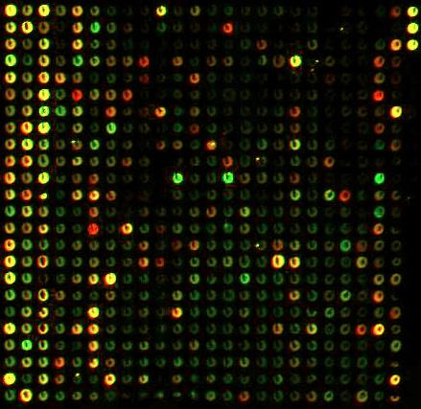
Black box view of
Machine Learning
Test-data
Training data
Model
Model
Magic black box
(learning machine)
Prediction Left or Right
Imaginary Hand Movements

Slide 6
Linear Support Vector Machines
Data: <x_{i},y_{i}>, i=1,..,l
x_{i} ∈ R^{d}
y_{i} ∈ {-1,+1}
x2
=+1
=-1
x1

Slide 7
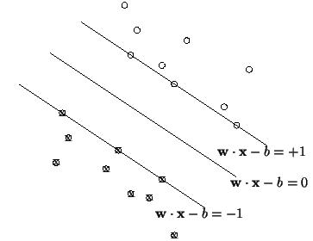
Definitions
Define the hyperplane H such that:
x_{i}•w+b ≥ +1 when y_{i} =+1
x_{i}•w+b ≤ -1 when y_{i} =-1
H1
H2
d⁺
d⁻
H

Slide 8
Maximizing the margin
We want a classifier with as big margin as possible.
H1
H
H2
d+
d-

Slide 9
Problems with linear SVM
=-1
=+1
What if the decison function is not a linear?

Slide 10
Support Vector Machines
Nonlinear Kernel Functions
X
X
X
X
X
X
X
O
O
X
O
O
O
O
X
O
O
X
O
O
O
O
O
O

Slide 11
Non-linear SVM 1
The Kernel trick a function φ that maps the data into another space:
=-1
=+1
φ
=-1
=+1

Slide 12
Non-linear svm 2
The function we end up optimizing is:
Max Ld = ∑α_{i} – ½∑ y_{j}y_{i} α_{j}α_{i}K(x_{i}•x_{j}),
Subject to:
w = ∑α_{i}y_{i}x_{i}
∑α_{i}y_{i} = 0
Notes:
In Book, (6.40)-(6.42)

Slide 13
Overtraining/overfitting
This means that we have learned the training data very well, but we can not classify unseen examples correctly.
=-1
=+1

Slide 14

A practical example: motor imaginary classifing using SVM
Continue wavelet used to extract the frequency feature of rhythm(10-12Hz) of EEG.
Kernel SVM trained to classify motor imaginary(left or right hand imaginary moving).

Slide 15
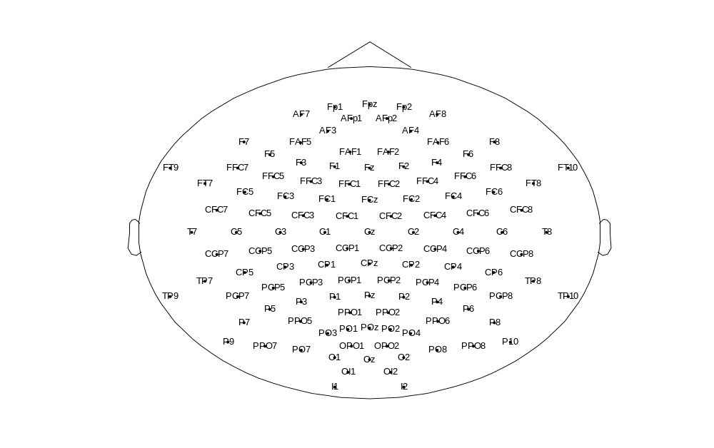
Position of EEG electrodes of 128 channels amplifier

Slide 16
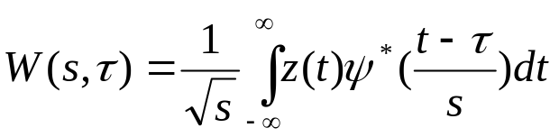
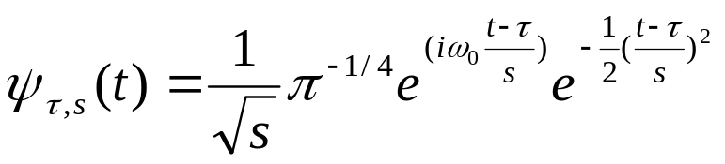

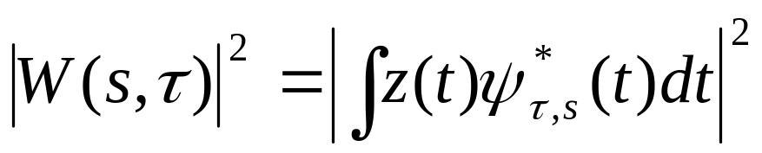

Feature extraction
Continue wavelet(morlet):
For signal z(t)(EEG data of a electrode of a time window) we extract the power feature of the scale:
is the scale power feature.

Slide 17
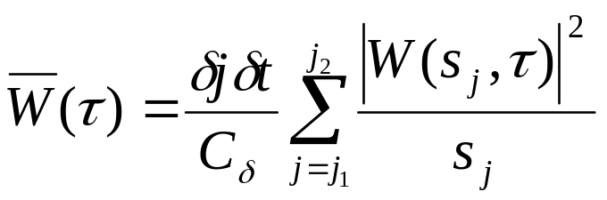


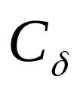
Feature extraction
rhythm part to j scales(j1~j2),the we gain the average power feature :
is the interval of scales, is the interval of t,
is the wavelet restructure factor.

Slide 18
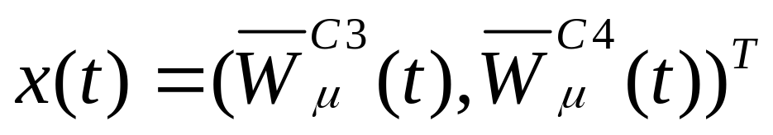
Feature extraction
There is our final feature vector ,that is average power feature of rhythm of EEG signal at electrodes C3 and C4:

Slide 19
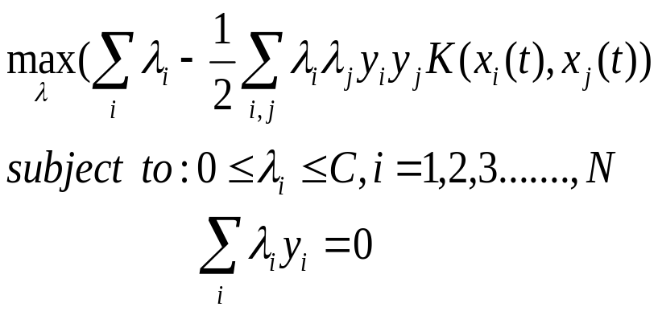
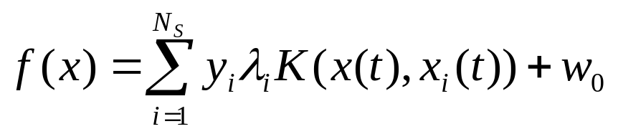

SVM classifier
Our target of training the SVM:
From training process, we get the discrimination function to classify the test data:
Ns is the support vector number that is the number of nonzero

Slide 20
Solving the optimization problem
In many cases any general purpose optimization package that solves linearly constrained equations will do.
  Newtons’ method
  Conjugate gradient descent
Other methods involves nonlinear programming techniques.

Slide 21
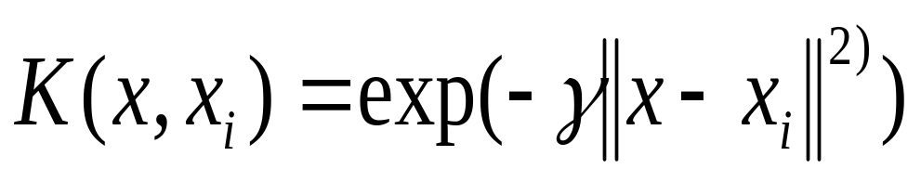

SVM classifier
K is the Gaussian kernel function:
Cross-validation to identify the two important parameters in this SVM classifier: C and

Slide 22
Cross-validation
For model selection purposes we estimated the generalization error of classifiers via 5-folds CV (cross-validation) to obtain the best regularization parameter C and the bandwidth σ of the Gaussian kernel :
Classifing Error rate
left
CV
Obtain SVM parameter
right
Notes:
5-folds CV
分成5组，每次用4 个去训练，留一组去测试，然后循环
Similar to leave one out

Slide 23
Cross-validation
Cross validation: Split the data into n sets, train on n-1 set, test on the set left out of training(n-folds CV)
1
left
1
Test set
1
2
3
2
1
right
Training set
3
2
2
3
3

Slide 24
Specific process
Data depict:
X:<1152*2*280>:<samples*electrodes*trials>
The first 140 trials for train have labels of left or right :
y:<1*140>:y(i)=‘1’ or ‘2’,’1’ for left ,’2’ for right
The last 140 trials for test have no labels

Slide 25
Specific process
Feature extraction:
%motor imaginary EEG feature extraction by morlet wavelet
electrodsNum=2; %C3 and C4
trialNum=140; %trials number
for i=1:trialNum %i:index of trials
for j=1:electrodsNum %j:index of electrodes
WT(i,j)=wt_eeg(x(1:1152,j,i),17.3,'cmor2-5/pi');
%wt_eeg() compute the power feature of the u rhythm,x is the signal %vector,17.3 is the scale of u rhythm,’cmor2-5/pi’ denoted wavelet function %to use
end
End
%%%%%%%%%%%%%%%%%%%%%%%%%%

Slide 26
Specific process
Feature extraction:
function coefs =wt_eeg(signal,scales,wname)
% scales=17.3;
% wname='cmor2-5/pi';
precis = 10;
signal = signal';
len =length(signal);
nbscales = length(scales);
[psi_integ,xval] = intwave(wname,precis);
wtype = wavemngr('type',wname);
if wtype==5 , psi_integ = conj(psi_integ); end
%%%%% to be continue

Slide 27
Specific process
Feature extraction:
xval = xval-xval(1);
dx = xval(2);
xmax = xval(end);
ind = 1;
for k = 1:nbscales
a = scales(k);
j = [1+floor([0:a*xmax]/(a*dx))];
if length(j)==1 , j = [1 1]; end
f = fliplr(psi_integ(j));
wcoef=wkeep(f,len);
coefs(ind,:) = (abs(-sqrt(a)*(sum(signal.*wcoef))))^2;
ind = ind+1;
End
%%%%%%%wt_eeg() end!!!

Slide 28
Specific process
SVM classifing:
Parameters = [0 3 3 0 3 40 1e-7 0];
[AlphaY, SVs, Bias, Parameters, nSV, nLabel] = SVMTrain(WT(1:140,:),y, Parameters);
[ClassRate, DecisionValue, Ns, ConfMatrix, PreLabels]= SVMTest(WT(141:280,:), y2, AlphaY, SVs, Bias,Parameters, nSV, nLabel);
%the two functions are from the SVM package of Junshui Ma %and Yi Zhao
%we aslo provide another realization of the SVM in next % slide,but not the Gaussian knernal

Slide 29
Specific process
SVM classifing:
y=[ones(1,27) (-1)*ones(1,11)];%y为类别标签，1和-1分别为
%不同的两类
Q='';
for i=1:c
Q=strcat(Q,'-',sprintf('x(%d)',i));
for j=1:c coef=sprintf('%f',(1/2*y(i)*y(j)*((s1(:,i)'*(s1(:,j))+1).^2)));
%s1为需分类的数据矩阵 Q=strcat(Q,'+(',coef,')*',sprintf('x(%d)',i),'*',sprintf('x(%d)',j));
end
end

Slide 30
Specific process
SVM classifing:
lb=zeros(length(y),1); %lb为目标函数中拉格朗日乘子的下界;
ub=500*ones(length(y),1);%ub为目标函数中拉格朗日乘子的上界;
aeq=y;beq=[0]; %目标函数需满足的线性等式约束条件： % aeq*x=beq;
A=[];b=[]; %目标函数需满足的线性不等式约束条件：A*x<=b;
x0=zeros(length(y),1);%拉格朗日乘子的初始值t=fmincon(inline(Q),x0,A,b,aeq,beq,lb,ub);%其中Q为目标函数，其%他的含义与上面注释相同，该函数被用于求解有约束条件的多%变量非线性规划的最小值问题
w=0;%w0为超平面的参数。
for j=1:length(y)
w=w+t(j)*y(j)*(s1(:,1)'*s1(:,j));
end
w0=1-w’s(j);
%%%%%%%%%%%%%%%END

Slide 31
classifing
Test data:x(t)
DF:f(x)>=1
SVM
DF:f(x)<=-1
=left
=right

Slide 32
Results
Thus, the best selected channels can be used without increasing the error estimate.
The resulting best channels agree well with the expected underlying cortical activity patterns during the mental tasks.

Slide 33
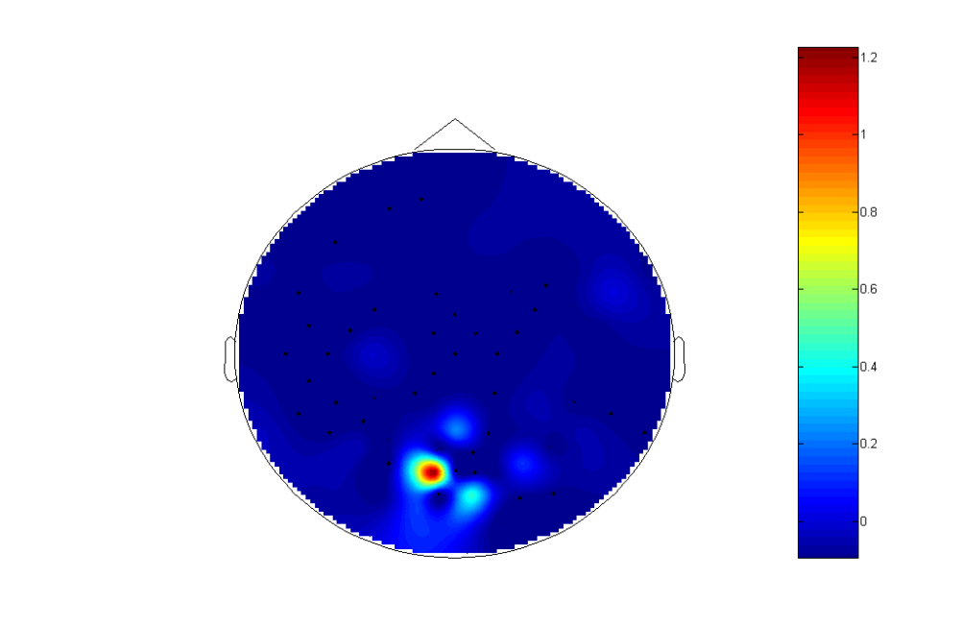
Notes:
将 118道电极 做PSD （power spectra density), 选取部分频率点，如2Hz sample，选12点得到
118*12的数据(X=)matrix or vector 作为训练样本点（输入空间维数），经过 SVM后得到分类函数
y=W*X+b, 根据W中的大小，确定出是哪一个点的贡献最大，该点必然对应了一个电极或一个频率点，如果以频率点为参考，可得到对应的128个电极的W，据此就可以画出 该图

Slide 34


Slide 35
Conclusions
We have learned to use some basic principles of SVM.
SVM can be useful for example in predicting mental tasks and channel selection.

